Slide 1
Improving customer experience with CloudFront
By: Stephen Sailor

Slide 2






About CleanSlate
OUR SPEAKER
WHO WE ARE
Founded in 2000, we are a privately held company, headquartered in Carmel, Indiana. Voted “Best Places to Work in Indiana” from 2016 through 2018
CleanSlate dedicated practices:
Cloud, Enterprise Integration, Salesforce
Our team has a combined total of 49 years of cloud experience. Our heads are in the clouds…
STEPHEN SAILOR
Senior Engineer
AWS Certified Cloud Practitioner
AWS Certified Security – Specialty
AWS Certified Developer – Associate
AWS Certified Solutions Architect – Associate
AWS Certified SysOps Administrator – Associate
AWS Certified DevOps Engineer - Professional
#sponsor-cleanslate
OUR PARTNERS

Slide 3
Technology Group

Slide 4
Travel Group

Slide 5
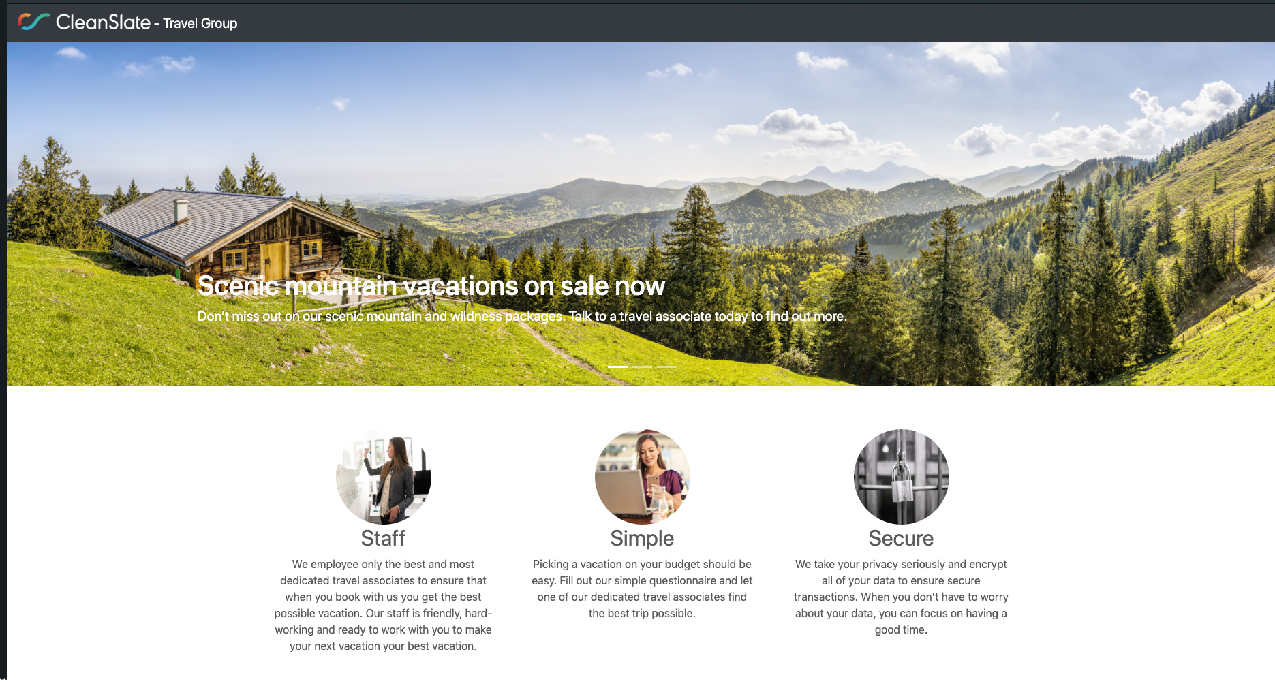

Marketing SITE
PROMOTIONAL VIDEO

Slide 6
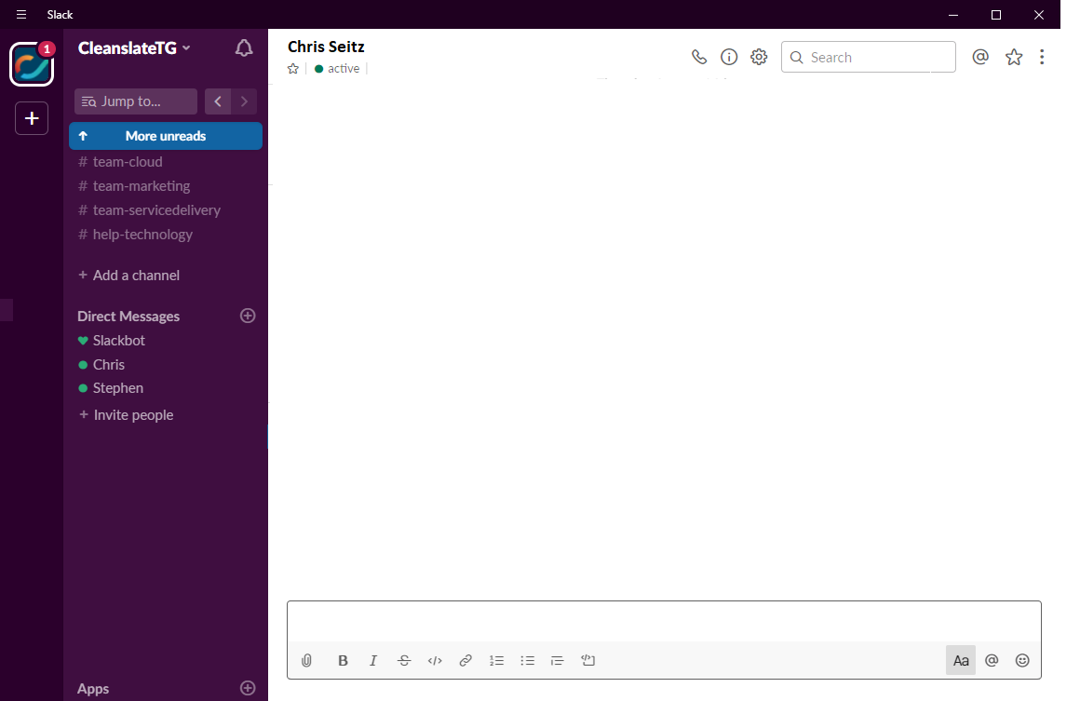
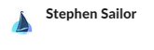

Hey Chris, I had a great idea for company growth.
Awesome, what is it?
I was thinking maybe we change company direction from technology and become a travel agency.
We could be the CleanSlate Travel Group
Uhhh…… what?
I figured you would be skeptical, so I’ve already created the marketing site and a promotional video to show you
Where is this site now?
It’s local on my machine
Ok, I’ll humor you. Show me your plan of how we would even host this site if we did this.
Great, give me like 3 minutes and I’ll make a diagram

Slide 7
10 MINUTES LATER…

Slide 8
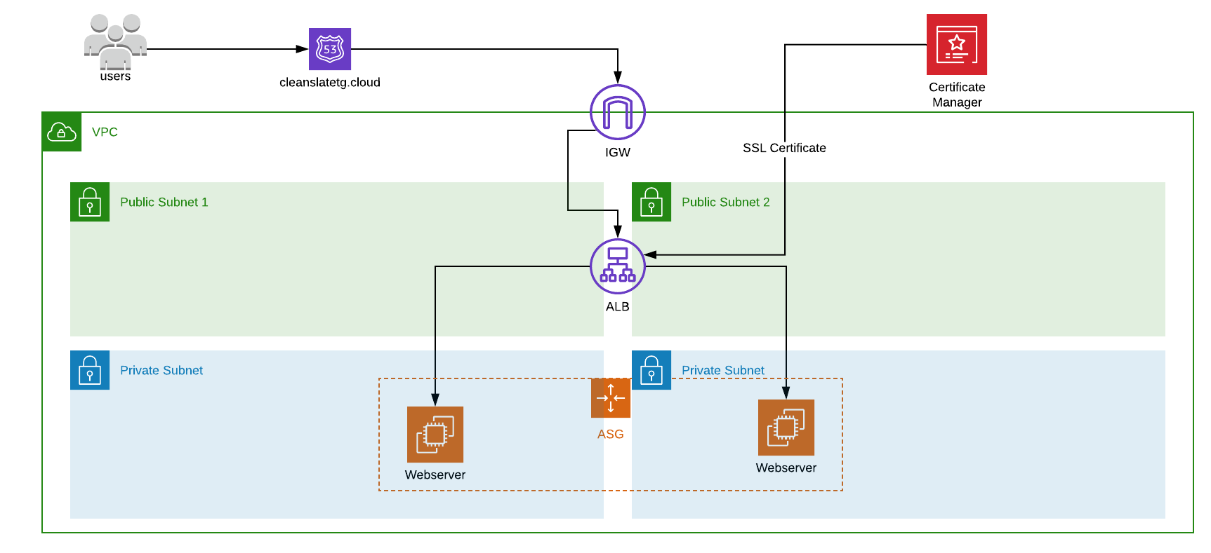
Infrastructure

Slide 9
Hey, I emailed you the the diagram, did you see it?
Yes, I am looking at it now
We could do this; I mean there are several pros to this design, it’s highly available, self healing, it has a small
attack surface and it allows for us to use SSL for our web traffic
Sure, those points are all true however I can foresee this design possibly becoming costly, it will require patching
for instances, it could have poor performance for users not close to where we are hosting it and in truth this is
more effort than I would want to put in for this. I’m sorry but I can’t approve this.
Ok, those are all fair points. I can fix it though, let me take another swing at it. I know I can get it right.
Alright, let’s see it
Great, give me like 3 minutes and I’ll update the diagram

Slide 10



Infrastructure Overview
COMPONENTS
DNS – Route 53
Private Networking - VPC
SSL Cert – Certificate Manager
Load Balancing – ALB
Web Servers – EC2
Capacity Scaling – Auto Scaling
PROS
Highly available
Self healing
Small attack surface
Secure web traffic (SSL)
CONS
Can be costly
Patching needed for instances
Poor performance at distance
Over engineered for situation

Slide 11
10 MINUTES LATER…

Slide 12
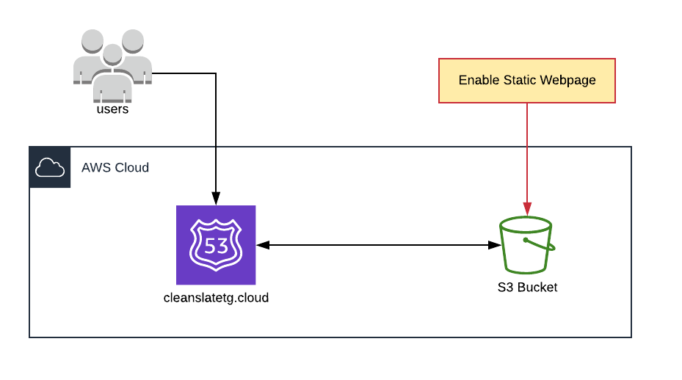
Infrastructure V2

Slide 13
Hey, I emailed you the updated diagram, did you see it?
Yes, I am looking at it now
So in this new version I fixed some of the things you talked about. This new version will be much cheaper, require
no patching and is still highly available.
Ok, I feel like this is a step in the right direction but not a fully baked solution. While you did simplify it you also
missed some things. This new design won’t support SSL for web traffic, it will still have performance issues for
users accessing the site across the country / world, it also would require the S3 bucket to be public which we
don’t want to do. Finally this would give a user a poor experience. I’m sorry but I can’t approve this.
That’s fair, I see what your saying. I can fix it though. Give me one more shot, I know I can get it right.
Ok, last time though. If you don’t get it then we need to move on. Ok?
No problem, thanks. Give me like 2 minutes and I’ll have the updated diagram out to you.

Slide 14
Infrastructure V2 Overview
COMPONENTS
DNS – Route 53
File Storage – S3
Web Hosting – S3
PROS
Cheap
No patching required
Highly available
CONS
Doesn’t support SSL
Poor performance at distance
Requires bucket to be public
Poor user experience

Slide 15
10 MINUTES LATER…

Slide 16
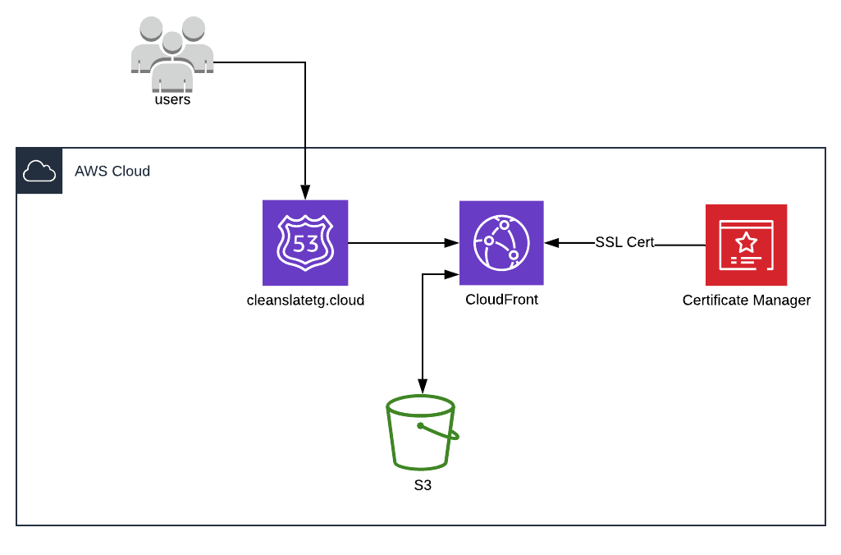
Infrastructure V3

Slide 17
Hey, I just emailed you the latest version.
Yep, I got it and I’m looking at it and I have to say this is looking a lot better
With this version I decided to use CloudFront to clear up a lot of the issues you were talking about
I’m not familiar with CloudFront, what is it?

Slide 18
CloudFront – What is it?
Amazon’s Content Delivery Network (CDN)
Edge Locations – Servers used for caching content closer to users
Different than regions or availability zones
More than regions or availability zones
Distribution – Grouping of objects to cache
Web – Static and dynamic content, distribution of files ...
RTMP – Streaming of files using Adobe Flash Media Servers RTMP Protocol.

Slide 19
CloudFront – Why use it?
Fast Content Delivery
Over 200 Edge Locations Worldwide
SSL Certification
Allows the ability to add SSL to content, only way to provide S3 content with SSL
Can be used with a variety of origins
S3
EC2
ECS
Non-AWS Resources
Cheap

Slide 20
CloudFront – Pricing
S3 Pricing
S3 Standard Storage = $0.023 / GB
Data Transfer to CloudFront = $0.00 / GB
CloudFront Pricing
Transfer out to Internet = $0.085 / GB (USA & Canada)
Requests
HTTP = $0.0075 / 10,000 Requests (USA & Canada)
HTTPS = $0.01 / 10,000 Requests (USA & Canada)
Invalidations = $0.005 / Path / Month (1st 1,000 path invalidations free)

Slide 21
So as you can see with this new design it’s far superior than the others because it’s cheap, requires no patching
it’s highly available, secure, allows for SSL traffic, helps to provide some DDoS protection and will perform well
even for users that are far away
Wow, ok I’m impressed. You know what why not, let’s give it a shot and see how the market responds. Go ahead
and deploy the site
Great! Thanks, I’ll stand it up now

Slide 22

Infrastructure V3 Overview
Pros
Cheap
No patching required
Highly available
Secure (No public S3 access)
Secure web traffic (SSL)
DDoS protection
Fast performance at distance
COMPONENTS
DNS – Route 53
SSL Cert – Certificate Manager
File Storage – S3
Content Caching – CloudFront
Web Hosting – CloudFront

Slide 23
Make It Real Checklist
Register a domain (Route 53)
Create SSL Certificate (Certificate Manager)
Create a private S3 bucket (S3)
Copy website files to S3 origin bucket (S3)
Create a CloudFront Distribution (CloudFront)
Update S3 Bucket Policy for CloudFront Access Only (S3)
Add Route 53 Record to Point to CloudFront (Route 53)
Test

Slide 24
What If / What About
What if we need to change an object in S3 and have it immediately take effect?
What if I add new objects to my S3 bucket, how long will I have to wait until they are available in CloudFront?
What if we hosted the webpage in S3 only?
What if we hosted the webpage in an S3 bucket far away, what would that do to performance?

Slide 25
Performance Testing
S3 |  |  |  |  |  | Total Cost: | $0.05
Test | Requests | Average (ms) | Min (ms) | Max (ms) | Error | S3 Cost/GB | S3 Cost/Requests
1 | 10,000 | 711 | 508 | 2331 | 0% | $0.025 | $0.00440
2 | 10,000 | 721 | 509 | 2501 | 0% | $0.025 | $0.00440
3 | 10,000 | 706 | 507 | 2084 | 0% | $0.025 | $0.00440
4 | 10,000 | 695 | 506 | 2520 | 0% | $0.025 | $0.00440
5 | 10,000 | 712 | 508 | 2557 | 0% | $0.025 | $0.00440
Average | 10,000 | 709 | 508 | 2399 | 0% | $0.025 | $0.0220
*Tested from a server in Indy
CloudFront |  |  |  |  |  |  |  | Total Cost: | $0.10
Test | Requests | Average (ms) | Min (ms) | Max (ms) | Error | S3 Cost/GB | S3 Cost/Requests | CF Costs/Data | CF Costs/HTTP
1 | 10,000 | 72 | 48 | 968 | 0% | $0.025 | - | $0.00765 | $0.00750
2 | 10,000 | 71 | 48 | 891 | 0% | $0.025 | - | $0.00765 | $0.00750
3 | 10,000 | 70 | 48 | 884 | 0% | $0.025 | - | $0.00765 | $0.00750
4 | 10,000 | 69 | 49 | 1064 | 0% | $0.025 | - | $0.00765 | $0.00750
5 | 10,000 | 73 | 49 | 965 | 0% | $0.025 | - | $0.00765 | $0.00750
Average | 10,000 | 71 | 48 | 954 | 0% | $0.025 | - | $0.03825 | $0.03750
1000% IMPROVEMENT

Slide 26
Future Improvements
Add the ability for users to create accounts and login – Cognito
Add dynamic data to the static webpage – API Gateway
Add a submission form that emails user a confirmation email – Lambda & SES
More …

Slide 27
Gotcha’s & Gremlins
Invalidations
Invalidations cost per path that is being invalidated
Target only objects you need to invalidate or change TTL to a more appropriate time
Custom SSL Certs & Alternate Domain Names
Can only add alternate domain names that are covered under the provided SSL certificate. Make sure that your SSL cert covers both the zone apex along with a wildcard cert for maximum options
Default Root Object
If you don’t provide a default root object for your webpage then CloudFront doesn’t know where to start
Route 53 Entries Needed
For proper DNS routing you specify an alternate domain name in CloudFront, but you must also have a corresponding records in Route 53 as well.
For cost optimization use an A records as an alias instead of a CNAME to reduce lookup costs

Slide 28
Advanced Topics
Custom Error Responses
Origin Failover
Realtime Video Streaming
Serverless Video on Demand
Pre-signed Cookies
Pre-signed URLs
CloudFront with Docker
Lambda @ Edge
Time to Live Patterns (TTL)
Targeted Object Invalidations
CloudFront with EC2
CloudFront with Non-AWS Resources
Monitoring
S3 Transfer Acceleration
CloudFront with EC2
Logging
Web Sockets with CloudFront
API Acceleration
Field-Level Encryption
Adding AWS WAF
Access Logs
Geo Restrictions
Console Reports

Slide 29



LET’S CONNECT
STEP ONE
STEP TWO
STEP THREE
Download Presentation Materials
Get Started with Code
Read and get hands on with proven resources
Learn & Build your own Skills
Connect with me and get involved with the community
Get Connected / Get Involved
https://bit.ly/2WRmGrv
https://bit.ly/2WJ1jbw
https://bit.ly/3dxWs2T
Stephen Sailor stephen.sailor@cleanslatetg.com
THANK YOU
#sponsor-cleanslate

Slide 30
our offer to You
As a THANK YOU for attending one of our speaking sessions, connect with us on our Slack Channel for one of the offers below.
#sponsor-cleanslate
Cloud Optimization Assessment with CloudCheckr - This evaluation will provide key recommendations for cloud cost optimization that will result in immediate savings opportunities – up to 30% cost savings
Cloud Strategic Planning Workshop – This workshop will introduce our proven Cloud Strategic Planning Framework and highlight the steps necessary to achieve successful cloud adoption including implementation of Cloud Architecture, Security, and Dev/Ops
Notes:
We'd like to thank you for attending this session. As a thank you, CleanSlate would like to make aware of some special offers for all attendees that we have found provide great value.
The first is offering is focused on Cloud Cost Optimization – everyone wants to save money!
The second is our planning workshop which is designed to help you build a strategy to get the most of your cloud investment
If you're interested, please head over to the CleanSlate Slack Channel and someone will connect with you.

